Slide 1


How might we enable the future of television that leverages the internet to augment live TV, movies, events, news and sports?
Crit One | Team 70 | Code Name: Quench
Kaitlin Hemric, MBA | FiFi Zhang, DESIGN | Prithvi Sriram, CS | Max Zeng, CM | Olivia Chen, CS

Slide 2

Problem
Pause and get info
Interrupted experience
Unsatisfying search results
Notes:
Pause screen and get info of people on the screen, links to their other films etc, the products they are wearing with links to shopping etc.

Slide 3
Quench
Quench is a video assistant software which enables users to gain real-time insights from their live-television content.
Quench is an AI powered content aggregator for live videos. Voice assistants are in the past. The future is for video assistants.
Quench analyses the user’s “pausing” patterns to generate valuable insights for content aggregators, content providers and viewer recommendations.

Slide 4
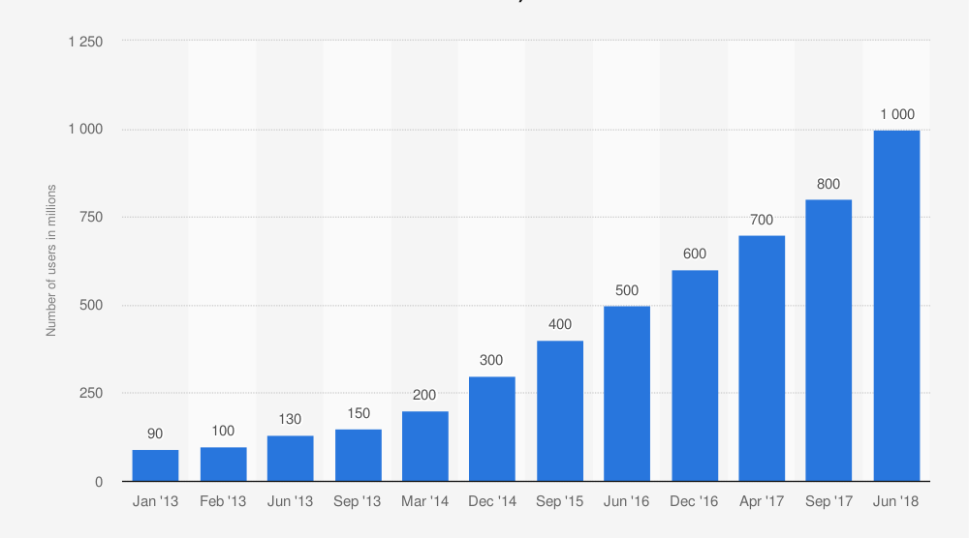
Market
All Content Providers
Smart web search
Live TV Events
All Content Providers
Sports, News, musics
Web Search
Live News aggregation
Notes:
Since we need to negotiate licensing agreement and build up our internal database
Plan to market in 3 different phases, alongside with users population growth.
Basic Smart search on the internet and a few of the content providers. Appealing to the customers with the immediate desire of this function;
Incorporate content from the live tv channels, especially channels already in the TV service bundle (ESPN, HBO, etc.)
Content from most of the content providers (Youtube, Netflix, Hulu) and achieve a 250 billion dollars market.

Slide 5

Business Model
Cost Structure
High in fixed costs:
Human Resources
Research and Development
Licensing
Proving Value
Revenue Stream
Viewers
WTP: $0.000001
Content Providers
WTP:
Advertisers
WTP:

Slide 6
Supporting Trends
Technological Trends
Advanced artificial intelligence eg. voice assistant
Advanced recommendations
Market Trends
Live content aggregators and retailers
More video-based programs rather than the text-based
Notes:
Increasing live content aggregators like Twitch and Hulu and retailers like AT&T, Disney+, Apple TV, Netflix, etc.
Increasing video viewing in contrast to text based content over the Internet.

Slide 7
Thank you

Slide 8
Demand Side
Viewers: Prime + IMDB
Content Provider: Advertising / Marketing
Advertisers: Video Advertising
Notes:
Substitutes
Internet Search
Voice Service (Siri, Alexa)

Slide 9
New
Old
Video Assistant
Integration with TV
Used Over Voice in real time
Content aggregator for live videos
Voice-based aggregation
Ads and content suggestion
Notes:
One of the trends for instance is that the millenials and gen Z weren’t convinced of using a TV, while the elder generations expressed their love for TV.

Slide 10
Supply Side
YouTube : Ads in videos
Shazam: AI
Silicon Valley

Slide 11
Demand Side: WTP
Notes:
Substitutes
Internet Search
Voice Service (Siri, Alexa)

Slide 12
Supply Side: Feasibility
Data collection

Slide 13
New
Old
Video Assistant
Integration with TV
Used Over Voice in real time
Content aggregator for live videos
Voice-based aggregation
Ads and content suggestion
Notes:
One of the trends for instance is that the millenials and gen Z weren’t convinced of using a TV, while the elder generations expressed their love for TV.

